Slide 1
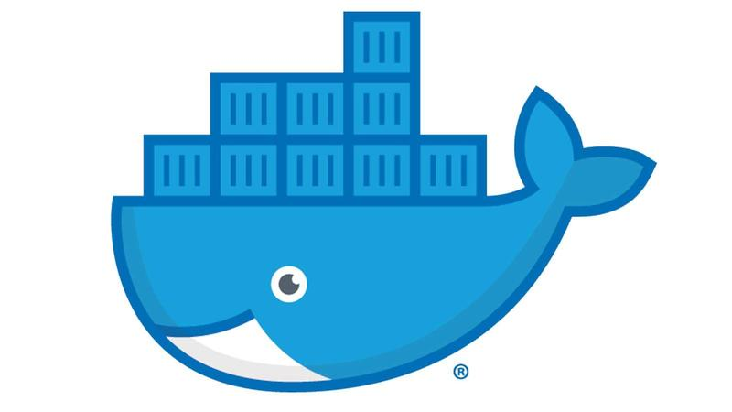
Docker Tips and Tricks
Michael Simons (msimons)

Slide 2
Agenda
Container Modes
Docker Layers
Multi-Stage Builds
Dockerfile Best Practices
Managing Disk Usage
Docker in Docker
Notes:
Intended for an audience who is currently using Docker and has some level of understanding of Docker
Will not cover any experimental features

Slide 3
Development Environments
Mac & Windows client (e.g. Windows 10) are considered development environments
Virtualization
Support running containers with differenct architectures than the host machine
Notes:
Consequences
Slower
May not support your scenario
Do not use for production environments

Slide 4
Windows Container Modes
Windows client supports both Windows and Linux containers
Default mode is Linux containers
Must explicitly switch between environments

Slide 5
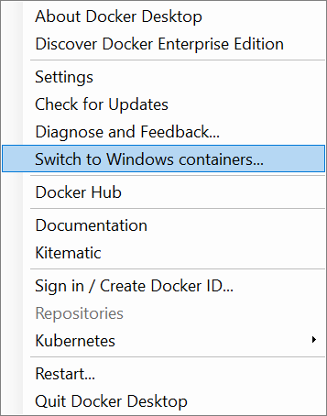
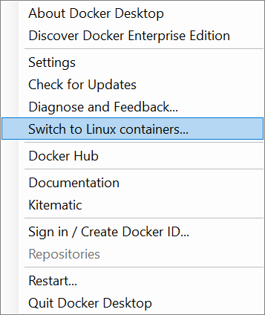

Switching Container Mode UI

Slide 6
Container Modes CLI
Retrieve Container Mode
docker version -f '{{ .Server.Os }}'
Switch Container Mode
$Env:ProgramFiles\Docker\Docker\DockerCli.exe –SwitchDaemon

Slide 7
Container Modes in Practice
PS D:\> docker pull mcr.microsoft.com/windows/nanoserver:1809
1809: Pulling from windows/nanoserver
no matching manifest for unknown in the manifest list entries
PS D:\> docker version -f '{{ .Server.Os }}'
linux
PS D:\> & $Env:ProgramFiles\Docker\Docker\DockerCli.exe –SwitchDaemon
PS D:\> docker version -f '{{ .Server.Os }}'
windows
PS D:\> docker pull mcr.microsoft.com/windows/nanoserver:1809
1809: Pulling from windows/nanoserver
4afaf8a8c3fa: Pull complete
Digest: sha256:535887492a56d570a018063d259a99e576cf6092204f87c0d2937fb160e5b090
Status: Downloaded newer image for mcr.microsoft.com/windows/nanoserver:1809

Slide 8
Docker Layers
Each image consists of a series of layers
Based on a union file system
One of the reasons Docker is so lightweight
Each Dockerfile instruction corresponds to a layer

Slide 9
Union File System
Image 2 ▲ File 1, File 2
Image 3 File 2
Image 1 File 1, File 2
▲ File 1
- File 1
+ File 2
+ File 2
+ File 2
+ File 1
+ File 1
+ File 1

Slide 10
Shared Docker Layers
Union file systems allows common layers to be shared between images and containers
Image 1
app1 binaries
Image 2
Image 3
ASP.NET Core Runtime
app2 binaries
scripts
.NET Core Runtime
Python
.NET Core Runtime
Windows Nano Server (1809)
Windows Nano Server (1809)
Windows Nano Server (1809)

Slide 11
Docker Layering Example
FROM ubuntu:disco
RUN apt-get update
RUN apt-get install -y curl

Slide 12
View Docker Layers
PS D:\> docker image ls training-day
REPOSITORY TAG IMAGE ID CREATED SIZE
training-day curl 9686a8e92900 14 minutes ago 114MB
PS D:\> docker history training-day:curl
IMAGE CREATED CREATED BY SIZE
9686a8e92900 7 minutes ago /bin/sh -c apt-get install -y curl 15.2MB
f86b6d0f93c1 8 minutes ago /bin/sh -c apt-get update 23.5MB
9b17fc7d6848 4 weeks ago /bin/sh -c #(nop) CMD ["/bin/bash"] 0B
<missing> 4 weeks ago /bin/sh -c mkdir -p /run/systemd && echo 'do… 7B
<missing> 4 weeks ago /bin/sh -c rm -rf /var/lib/apt/lists/* 0B
<missing> 4 weeks ago /bin/sh -c set -xe && echo '#!/bin/sh' > /… 933B
<missing> 4 weeks ago /bin/sh -c #(nop) ADD file:b82101f178f1bebe3… 75.4MB

Slide 13
Bad Layering Example
FROM ubuntu:disco
RUN apt-get update
RUN apt-get install -y curl
RUN rm -rf /var/lib/apt/lists/*

Slide 14
View Docker Layers
PS D:\> docker image ls training-day
REPOSITORY TAG IMAGE ID CREATED SIZE
training-day curl-cleanup 8c8ccd7a25c2 2 minutes ago 114MB
training-day curl 9686a8e92900 14 minutes ago 114MB
PS D:\> docker history training-day:curl-cleanup
IMAGE CREATED CREATED BY SIZE
8c8ccd7a25c2 5 minutes ago /bin/sh -c rm -rf /var/lib/apt/lists/* 0B
9686a8e92900 16 minutes ago /bin/sh -c apt-get install -y curl 15.2MB
f86b6d0f93c1 17 minutes ago /bin/sh -c apt-get update 23.5MB
9b17fc7d6848 4 weeks ago /bin/sh -c #(nop) CMD ["/bin/bash"] 0B
<missing> 4 weeks ago /bin/sh -c mkdir -p /run/systemd && echo 'do… 7B
<missing> 4 weeks ago /bin/sh -c rm -rf /var/lib/apt/lists/* 0B
<missing> 4 weeks ago /bin/sh -c set -xe && echo '#!/bin/sh' > /… 933B
<missing> 4 weeks ago /bin/sh -c #(nop) ADD file:b82101f178f1bebe3… 75.4MB

Slide 15
Good Layering Example
FROM ubuntu:disco
RUN apt-get update \
&& apt-get install -y curl \
&& rm -rf /var/lib/apt/lists/*

Slide 16
View Docker Layers
PS D:\> docker image ls training-day
REPOSITORY TAG IMAGE ID CREATED SIZE
training-day curl-fixed 5e8865b816e5 31 seconds ago 90.6MB
training-day curl 9686a8e92900 14 minutes ago 114MB
PS D:\> docker history training-day:curl-fixed
IMAGE CREATED CREATED BY SIZE
5e8865b816e5 2 minutes ago /bin/sh -c apt-get update && apt-get ins… 15.2MB
9b17fc7d6848 4 weeks ago /bin/sh -c #(nop) CMD ["/bin/bash"] 0B
<missing> 4 weeks ago /bin/sh -c mkdir -p /run/systemd && echo 'do… 7B
<missing> 4 weeks ago /bin/sh -c rm -rf /var/lib/apt/lists/* 0B
<missing> 4 weeks ago /bin/sh -c set -xe && echo '#!/bin/sh' > /… 933B
<missing> 4 weeks ago /bin/sh -c #(nop) ADD file:b82101f178f1bebe3… 75.4MB

Slide 17
ADD Instruction
FROM buildpack-deps:buster-scm
ADD https://dotnetcli.blob.core.windows.net/dotnet/Sdk/3.0.100-preview5-011568/dotnet-sdk-3.0.100-preview5-011568-linux-x64.tar.gz
RUN mkdir -p /dotnet \
&& tar -zxf dotnet-sdk-3.0.100-preview5-011568-linux-x64.tar.gz -C /dotnet \
&& rm dotnet-sdk-3.0.100-preview5-011568-linux-x64.tar.gz

Slide 18
View Docker Layers
PS D:\> docker image ls training-day
REPOSITORY TAG IMAGE ID CREATED SIZE
training-day add 5c72bbbacc8c 45 seconds ago 783MB
PS D:\> docker history training-day:add
IMAGE CREATED CREATED BY SIZE COMMENT
5c72bbbacc8c About an hour ago /bin/sh -c mkdir -p /dotnet && tar -… 359MB
e75fb87da16a About an hour ago /bin/sh -c #(nop) ADD 751b174796976088bba86f… 130MB
38eb2db2a707 3 days ago /bin/sh -c apt-get update && apt-get install… 145MB
<missing> 3 days ago /bin/sh -c set -ex; if ! command -v gpg > /… 17.5MB
<missing> 3 days ago /bin/sh -c apt-get update && apt-get install… 16.4MB
<missing> 3 days ago /bin/sh -c #(nop) CMD ["bash"] 0B
<missing> 3 days ago /bin/sh -c #(nop) ADD file:e7b0b4ed23ac0ce3e… 114MB

Slide 19
Correct ‘ADD’ Pattern
FROM buildpack-deps:buster-scm
RUN curl -SL --output dotnet.tar.gz https://dotnetcli.blob.core.windows.net/dotnet/Sdk/3.0.100-preview5-011568/dotnet-sdk-3.0.100-preview5-011568-linux-x64.tar.gz \
&& mkdir -p /dotnet \
&& tar -zxf dotnet.tar.gz -C /dotnet \
&& rm dotnet.tar.gz

Slide 20
View Docker Layers
PS C:\Users\msimons> docker image ls training-day
REPOSITORY TAG IMAGE ID CREATED SIZE
training-day curl 7b7bfb810419 3 seconds ago 653MB
training-day add 5c72bbbacc8c 45 seconds ago 783MB
PS D:\> docker history training-day:curl
IMAGE CREATED CREATED BY SIZE COMMENT
7b7bfb810419 About an hour ago /bin/sh -c curl -SL --output dotnet.tar.gz h… 359MB
38eb2db2a707 3 days ago /bin/sh -c apt-get update && apt-get install… 145MB
<missing> 3 days ago /bin/sh -c set -ex; if ! command -v gpg > /… 17.5MB
<missing> 3 days ago /bin/sh -c apt-get update && apt-get install… 16.4MB
<missing> 3 days ago /bin/sh -c #(nop) CMD ["bash"] 0B
<missing> 3 days ago /bin/sh -c #(nop) ADD file:e7b0b4ed23ac0ce3e… 114MB

Slide 21
Multi-Stage Builds
Multi-stage builds are another mechanism to help create smaller lightweight images.

Slide 22
Problem
FROM mcr.microsoft.com/dotnet/core/sdk:2.2
WORKDIR /app
COPY . ./
RUN dotnet publish -c Release -o out
WORKDIR /app/out
ENTRYPOINT ["dotnet", "dotnetapp.dll"]

Slide 23
Undesirable Image Size
PS D:\> docker image ls training-day
REPOSITORY TAG IMAGE ID SIZE
training-day dotnetapp-sdk f9c59aaf3e00 1.76GB
PS D:\> docker images mcr.microsoft.com/dotnet/core/sdk:2.2
REPOSITORY TAG IMAGE ID SIZE
mcr.microsoft.com/dotnet/core/sdk 2.2 08663b8eaa01 1.74GB
PS D:\> docker images mcr.microsoft.com/dotnet/core/runtime:2.2
REPOSITORY TAG IMAGE ID SIZE
mcr.microsoft.com/dotnet/core/runtime 2.2 5821aefa479a 181MB

Slide 24
Solution
FROM mcr.microsoft.com/dotnet/core/sdk:2.2 AS build
WORKDIR /app
COPY . ./
RUN dotnet publish -c Release -o out
FROM mcr.microsoft.com/dotnet/core/runtime:2.2
WORKDIR /app
COPY --from=build /app/out ./
ENTRYPOINT ["dotnet", "dotnetapp.dll"]

Slide 25
Desirable Image Size
PS D:\> docker image ls training-day
REPOSITORY TAG IMAGE ID CREATED SIZE
training-day dotnetapp-runtime 97cae90eaf37 10 seconds ago 181MB
training-day dotnetapp-sdk f9c59aaf3e00 39 seconds ago 1.76GB

Slide 26
Dockerfile Best Practices
https://docs.docker.com/develop/develop-images/dockerfile_best-practices/

Slide 27
Disk Usage
PS D:\> docker system df
TYPE TOTAL ACTIVE SIZE RECLAIMABLE
Images 54 3 12.67GB 12.63GB (99%)
Containers 36 0 170.3kB 170.3kB (100%)
Local Volumes 0 0 0B 0B
Build Cache 0 0 0B 0B
Notes:
Remember on Windows client in Linux container mode, Docker is running in VM. If Docker says there is no disk space left yet you see lots of disk space, it is because the VM is out of disk space.

Slide 28
Pruning Containers
PS D:\> docker container prune --help
Usage: docker container prune [OPTIONS]
Remove all stopped containers
Options:
--filter filter Provide filter values (e.g. 'until=<timestamp>')
-f, --force Do not prompt for confirmation
Notes:
Be proactive in the first place and use –rm when running containers.

Slide 29
Pruning Images
PS D:\> docker image prune --help
Usage: docker image prune [OPTIONS]
Remove unused images
Options:
-a, --all Remove all unused images, not just dangling ones
--filter filter Provide filter values (e.g. 'until=<timestamp>')
-f, --force Do not prompt for confirmation

Slide 30
Pruning Everything
PS D:\> docker system prune --help
Usage: docker system prune [OPTIONS]
Remove unused data
Options:
-a, --all Remove all unused images not just dangling ones
--filter filter Provide filter values (e.g. 'label=<key>=<value>')
-f, --force Do not prompt for confirmation
--volumes Prune volumes
Notes:
What this doesn't clean by default:
Running containers (and their logs)
Tagged images
Volumes

Slide 31
Docker in Docker
Scenarios
Execute script (e.g. Python, PowerShell, etc.) that depends on Docker CLI, but don’t want to install scripting technology locally.
Containerize CI pipeline that depends on Docker CLI

Slide 32
Docker CLI in Docker
Build image that includes the Docker CLI
Utilize the Docker Daemon from the host
Notes:
Running the Docker Daemon within a container has issues and is not recommended.

Slide 33
Install Docker within Dockerfile
FROM debian:stretch
# install Docker
RUN apt-get update \
&& apt-get install -y --no-install-recommends \
apt-transport-https \
curl \
gnupg \
software-properties-common \
&& rm -rf /var/lib/apt/lists/*
RUN curl -fsSL https://download.docker.com/linux/debian/gpg | apt-key add - \
&& add-apt-repository "deb [arch=amd64] https://download.docker.com/linux/debian $(lsb_release -cs) stable" \
&& apt-get update \
&& apt-get install -y --no-install-recommends \
docker-ce \
&& rm -rf /var/lib/apt/lists/*

Slide 34
Run Docker CLI in Docker
Linux
docker run -it --rm -v /var/run/docker.sock:/var/run/docker.sock docker
Windows
docker run -it --rm -v \\.\pipe\docker_engine:\\.\pipe\docker_engine docker

Slide 35
Usage Example
docker run -d --restart=unless-stopped --name cleanup
-v /var/run/docker.sock:/var/run/docker.sock
docker /bin/sh -c
"while true; do docker system prune -f; sleep 1h; done"

Slide 36

Q & A

